Slide 1
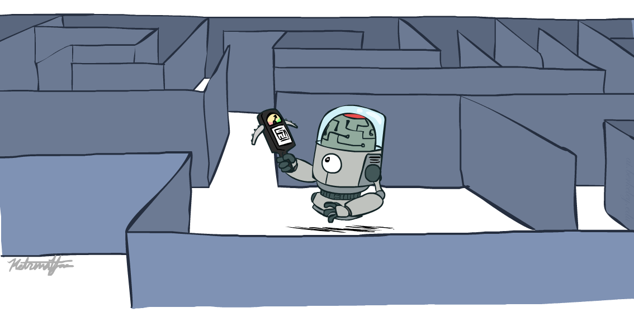
CS 188: Artificial Intelligence
Informed Search
Instructors: Dan Klein and Pieter Abbeel
University of California, Berkeley
[These slides were created by Dan Klein and Pieter Abbeel for CS188 Intro to AI at UC Berkeley. All CS188 materials are available at http://ai.berkeley.edu.]
Notes:
Please retain proper attribution, including the reference to ai.berkeley.edu. Thanks!

Slide 2

Today
Informed Search
Heuristics
Greedy Search
A* Search
Graph Search

Slide 3
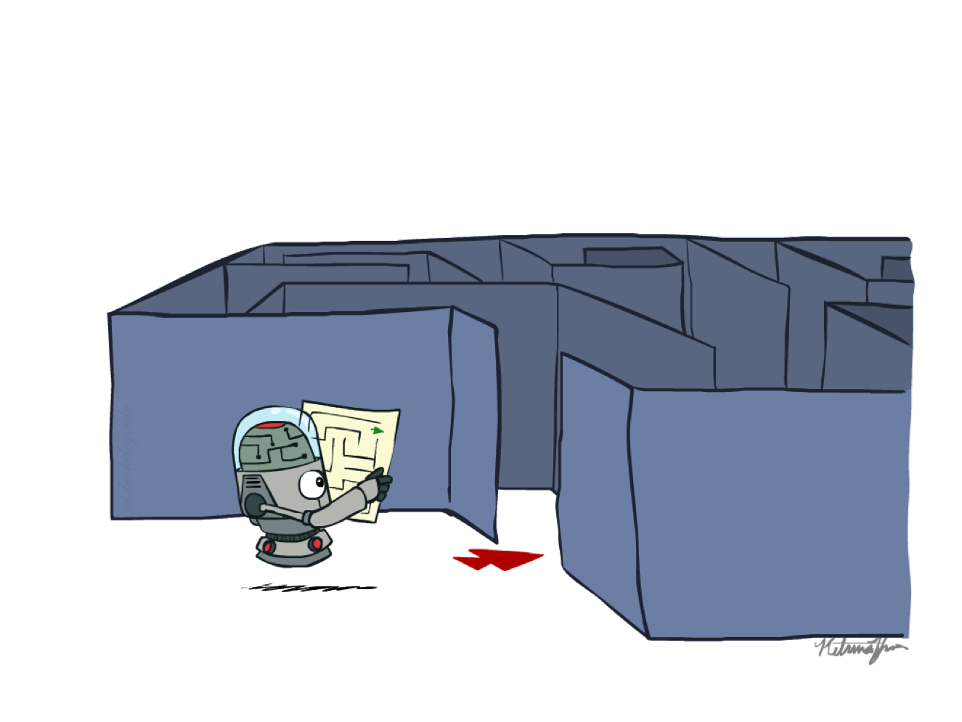
Recap: Search

Slide 4
Recap: Search
Search problem:
States (configurations of the world)
Actions and costs
Successor function (world dynamics)
Start state and goal test
Search tree:
Nodes: represent plans for reaching states
Plans have costs (sum of action costs)
Search algorithm:
Systematically builds a search tree
Chooses an ordering of the fringe (unexplored nodes)
Optimal: finds least-cost plans

Slide 5
Example: Pancake Problem
Cost: Number of pancakes flipped
Notes:
Gates, W. and Papadimitriou, C., "Bounds for Sorting by Prefix Reversal.", Discrete Mathematics. 27, 47-57, 1979.

Slide 6
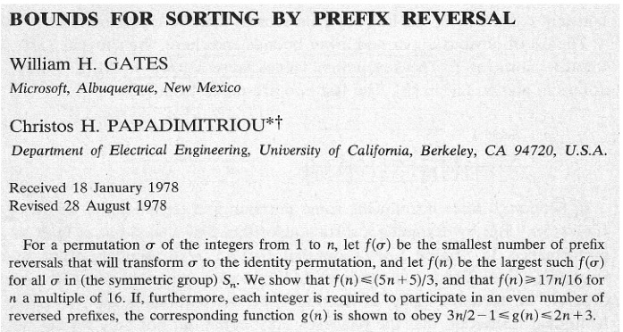
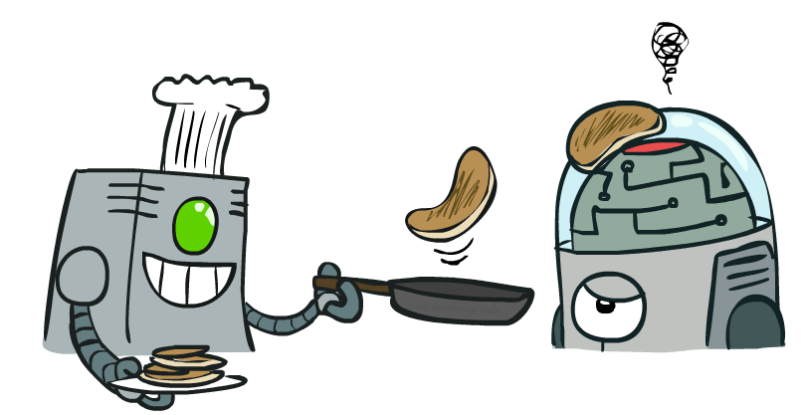
Example: Pancake Problem
Notes:
Gates, W. and Papadimitriou, C., "Bounds for Sorting by Prefix Reversal.", Discrete Mathematics. 27, 47-57, 1979.

Slide 7
Example: Pancake Problem
State space graph with costs as weights
4
2
3
2
3
4
3
4
2
3
2
2
4
3
Notes:
A* expanded 8100 ; Path cost = 33
UCS expanded 25263 . Path cost = 33
Greedy expanded 10 . Path cost = 41
[0, 7, 5, 3, 2, 1, 4, 6]
(7, 0, 5, 3, 2, 1, 4, 6)
(6, 4, 1, 2, 3, 5, 0, 7)
(3, 2, 1, 4, 6, 5, 0, 7)
(1, 2, 3, 4, 6, 5, 0, 7)
(5, 6, 4, 3, 2, 1, 0, 7)
(6, 5, 4, 3, 2, 1, 0, 7)
(0, 1, 2, 3, 4, 5, 6, 7)

Slide 8
General Tree Search
Action: flip top two Cost: 2
Action: flip all four Cost: 4
Path to reach goal:
Flip four, flip three
Total cost: 7
Notes:
You know exactly where you came from and how you got there, but you have no idea where you’re going. But, you’ll know it when you see it.

Slide 9
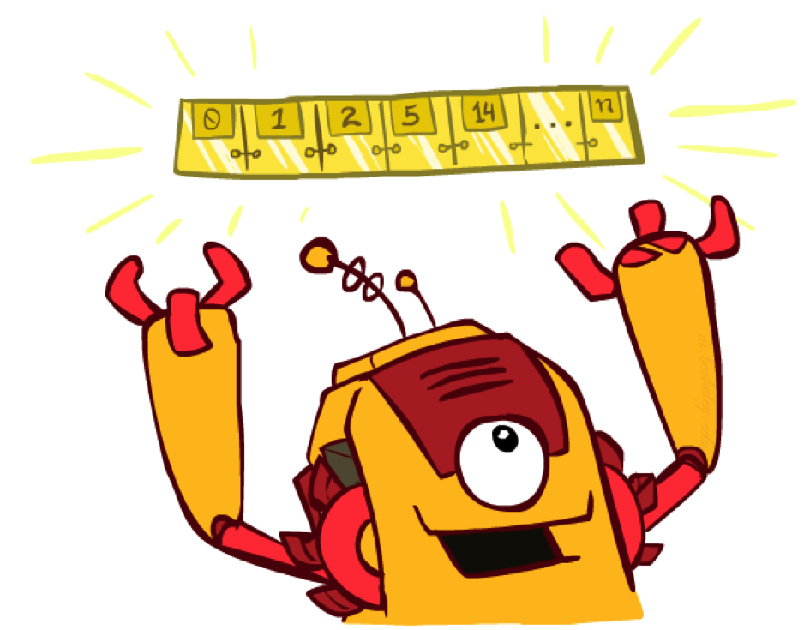
The One Queue
All these search algorithms are the same except for fringe strategies
Conceptually, all fringes are priority queues (i.e. collections of nodes with attached priorities)
Practically, for DFS and BFS, you can avoid the log(n) overhead from an actual priority queue, by using stacks and queues
Can even code one implementation that takes a variable queuing object

Slide 10
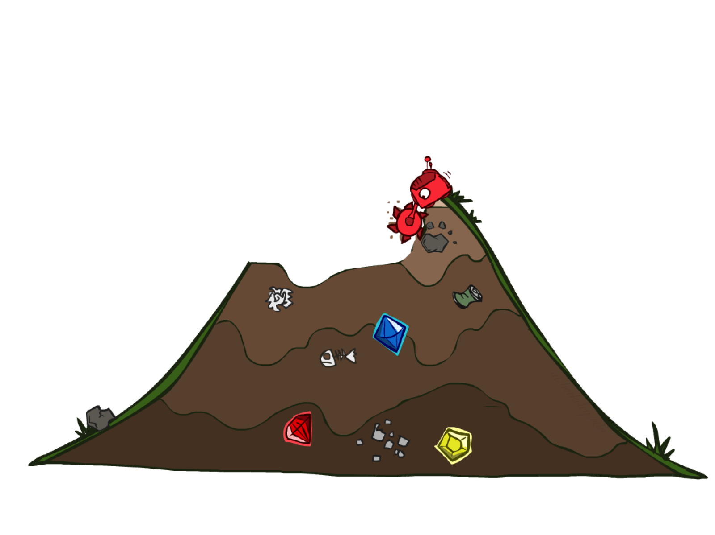
Uninformed Search

Slide 11
Uniform Cost Search
Strategy: expand lowest path cost
The good: UCS is complete and optimal!
The bad:
Explores options in every “direction”
No information about goal location
c ≤ 1
…
c ≤ 2
c ≤ 3
Start
Goal
[Demo: contours UCS empty (L3D1)]
[Demo: contours UCS pacman small maze (L3D3)]

Slide 12

Video of Demo Contours UCS Empty

Slide 13
Video of Demo Contours UCS Pacman Small Maze

Slide 14
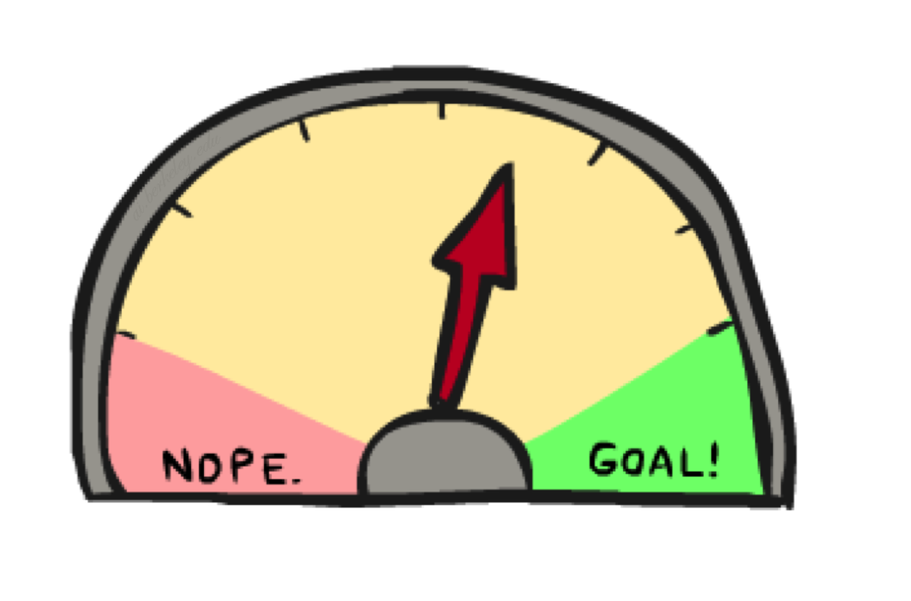
Informed Search

Slide 15
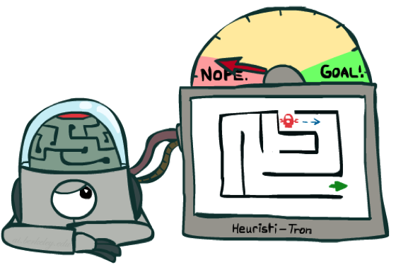
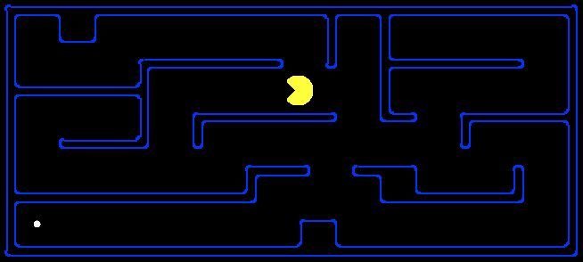
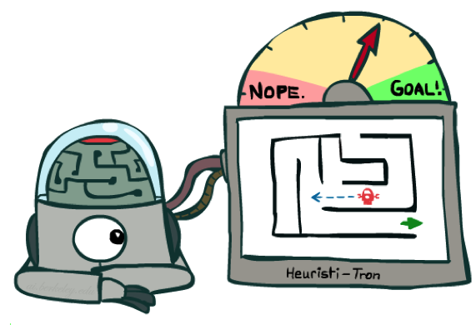
Search Heuristics
A heuristic is:
A function that estimates how close a state is to a goal
Designed for a particular search problem
Examples: Manhattan distance, Euclidean distance for pathing
10
5
11.2

Slide 16
Example: Heuristic Function
h(x)

Slide 17
Example: Heuristic Function
Heuristic: the number of the largest pancake that is still out of place
3
h(x)
4
3
4
3
0
4
4
3
4
4
2
3
Notes:
A* expanded 8100 ; Path cost = 33
UCS expanded 25263 . Path cost = 33
Greedy expanded 10 . Path cost = 41
[0, 7, 5, 3, 2, 1, 4, 6]
(7, 0, 5, 3, 2, 1, 4, 6)
(6, 4, 1, 2, 3, 5, 0, 7)
(3, 2, 1, 4, 6, 5, 0, 7)
(1, 2, 3, 4, 6, 5, 0, 7)
(5, 6, 4, 3, 2, 1, 0, 7)
(6, 5, 4, 3, 2, 1, 0, 7)
(0, 1, 2, 3, 4, 5, 6, 7)

Slide 18
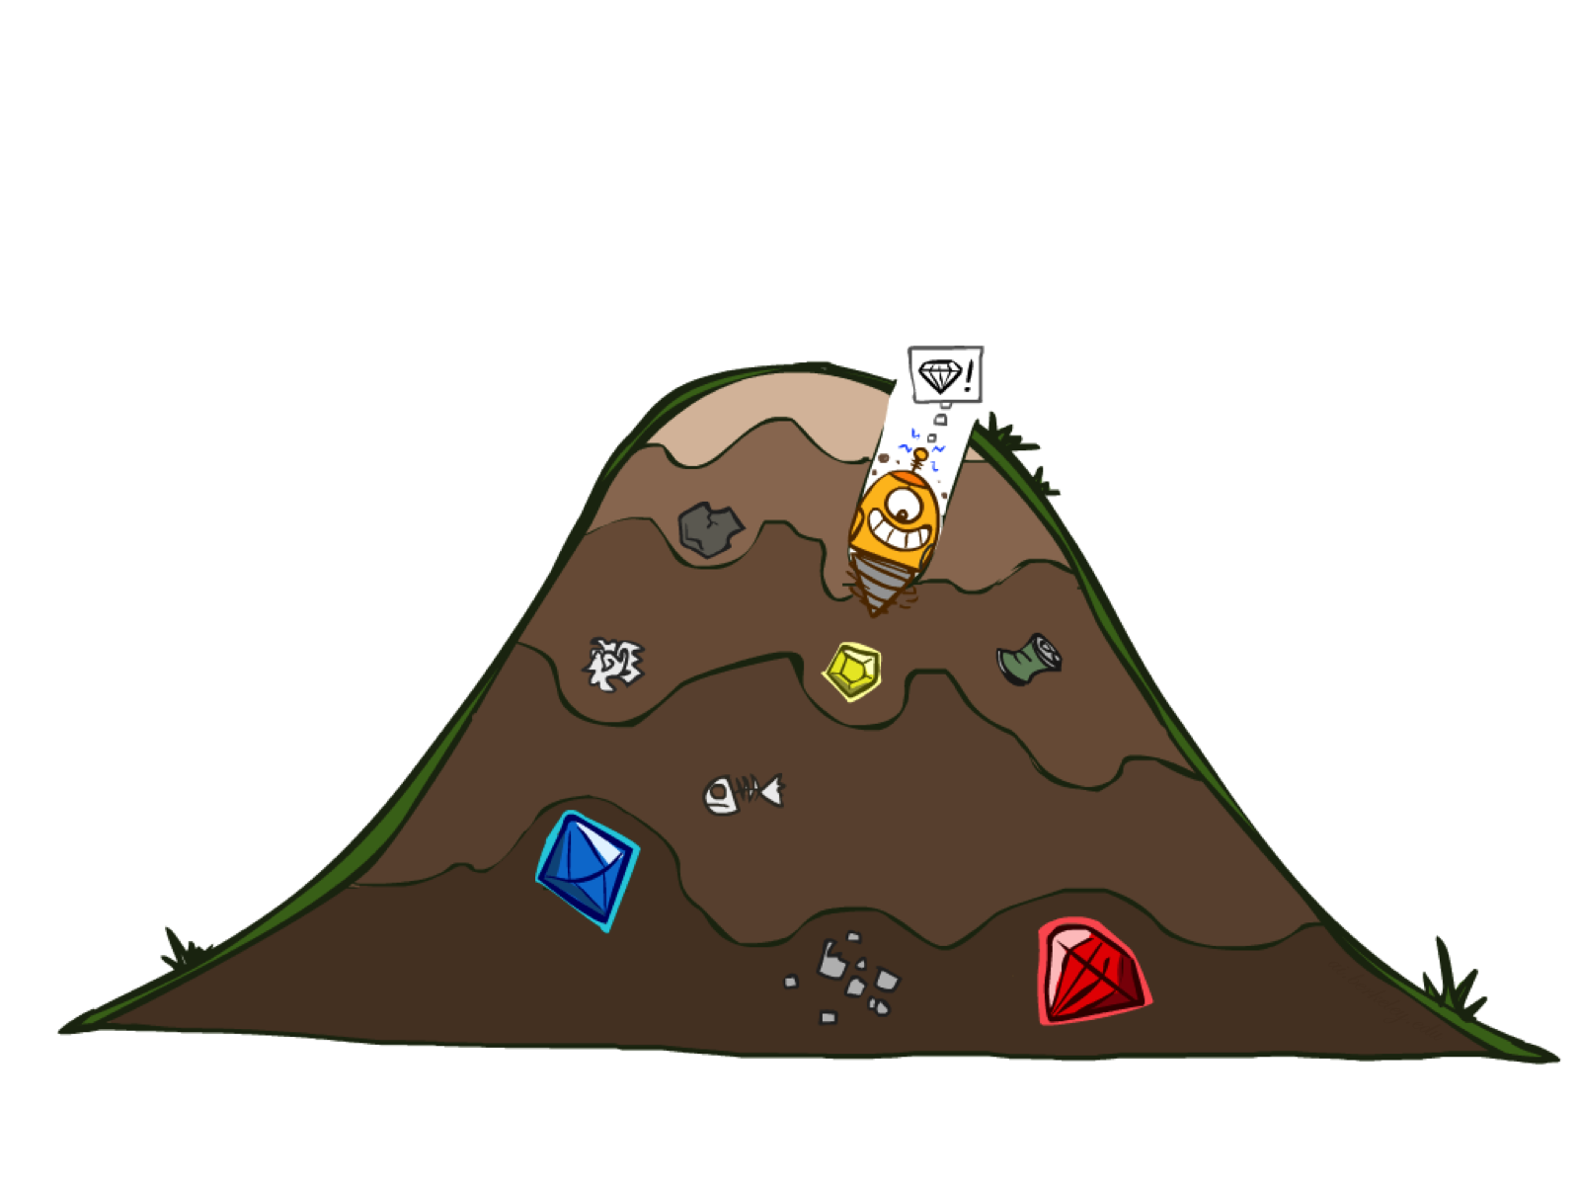
Greedy Search

Slide 19
Example: Heuristic Function
h(x)

Slide 20


Greedy Search
Expand the node that seems closest…
What can go wrong?

Slide 21
Greedy Search
b
Strategy: expand a node that you think is closest to a goal state
Heuristic: estimate of distance to nearest goal for each state
A common case:
Best-first takes you straight to the (wrong) goal
Worst-case: like a badly-guided DFS
…
b
…
[Demo: contours greedy empty (L3D1)]
[Demo: contours greedy pacman small maze (L3D4)]
Notes:
For any search problem, you know the goal. Now, you have an idea of how far away you are from the goal.

Slide 22
Video of Demo Contours Greedy (Empty)

Slide 23
Video of Demo Contours Greedy (Pacman Small Maze)

Slide 24
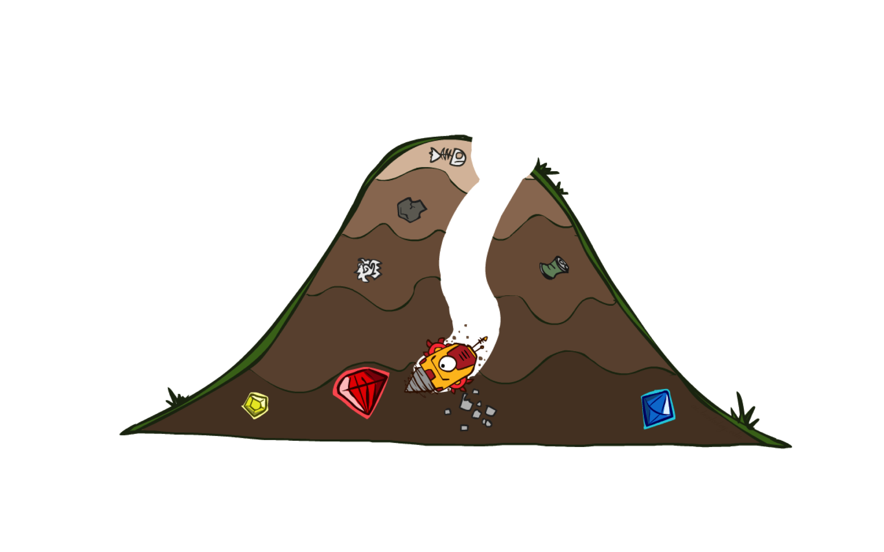
A* Search

Slide 25
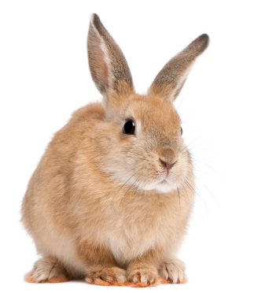
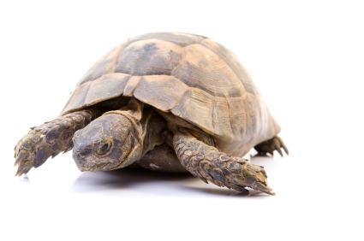

A* Search
UCS
Greedy
A*
Notes:
Notes: these images licensed from iStockphoto for UC Berkeley use.

Slide 26
Combining UCS and Greedy
Uniform-cost orders by path cost, or backward cost g(n)
Greedy orders by goal proximity, or forward cost h(n)
A* Search orders by the sum: f(n) = g(n) + h(n)
8
g = 0 h=6
S
e
h=1
g = 1 h=5
a
1
1
3
2
g = 2 h=6
g = 9 h=1
S
a
d
G
b
d
g = 4 h=2
e
h=6
1
h=5
h=2
h=0
1
g = 3 h=7
g = 6 h=0
g = 10 h=2
c
b
c
G
d
h=7
h=6
g = 12 h=0
G
Example: Teg Grenager

Slide 27
When should A* terminate?
Should we stop when we enqueue a goal?
No: only stop when we dequeue a goal
h = 2
A
2
2
S
h = 3
h = 0
G
2
B
3
h = 1

Slide 28
Is A* Optimal?
h = 6
1
A
3
S
h = 7
G
h = 0
5
What went wrong?
Actual bad goal cost < estimated good goal cost
We need estimates to be less than actual costs!

Slide 29
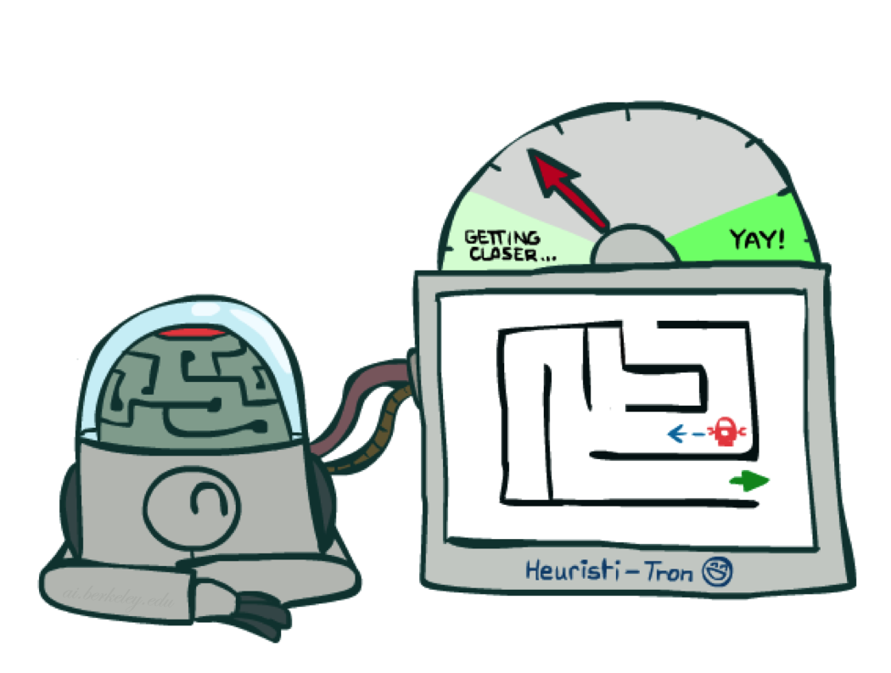
Admissible Heuristics

Slide 30
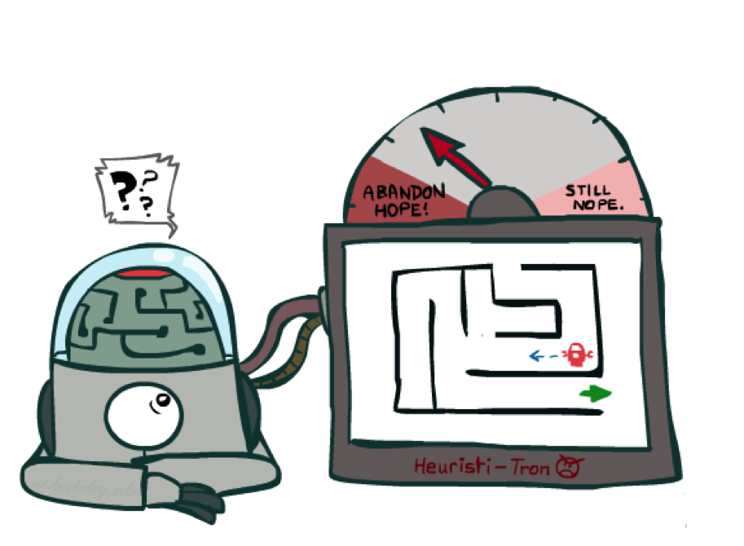
Idea: Admissibility
Inadmissible (pessimistic) heuristics break optimality by trapping good plans on the fringe
Admissible (optimistic) heuristics slow down bad plans but never outweigh true costs

Slide 31
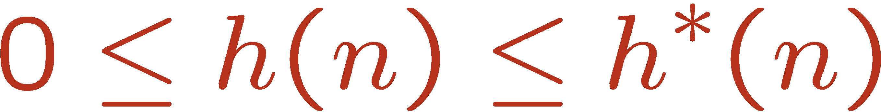
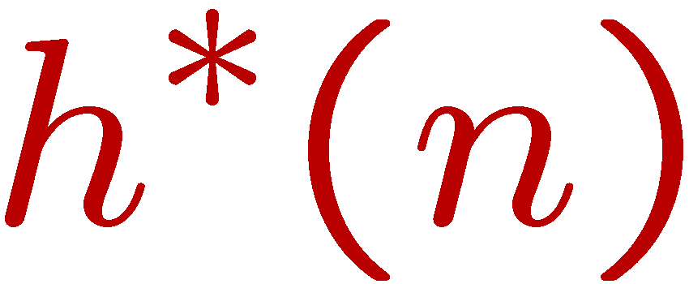
Admissible Heuristics
A heuristic h is admissible (optimistic) if:
where is the true cost to a nearest goal
Examples:
Coming up with admissible heuristics is most of what’s involved in using A* in practice.
4
15

Slide 32

Optimality of A* Tree Search

Slide 33


Optimality of A* Tree Search
Assume:
A is an optimal goal node
B is a suboptimal goal node
h is admissible
Claim:
A will exit the fringe before B
…

Slide 34
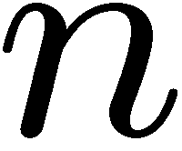
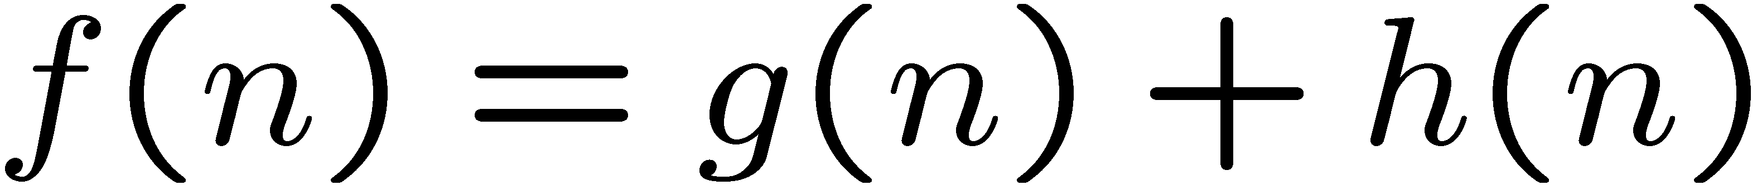
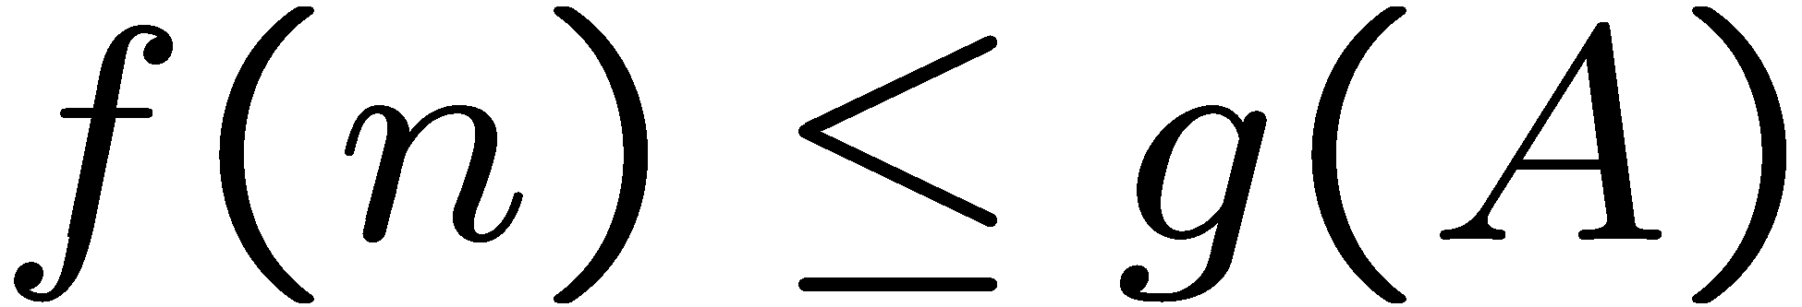
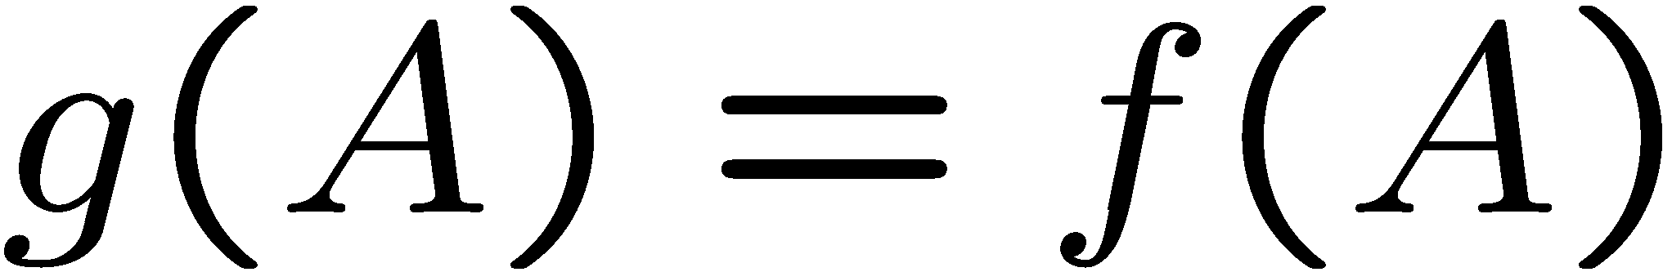
Optimality of A* Tree Search: Blocking
Proof:
Imagine B is on the fringe
Some ancestor n of A is on the fringe, too (maybe A!)
Claim: n will be expanded before B
f(n) is less or equal to f(A)
…
Definition of f-cost
Admissibility of h
h = 0 at a goal

Slide 35
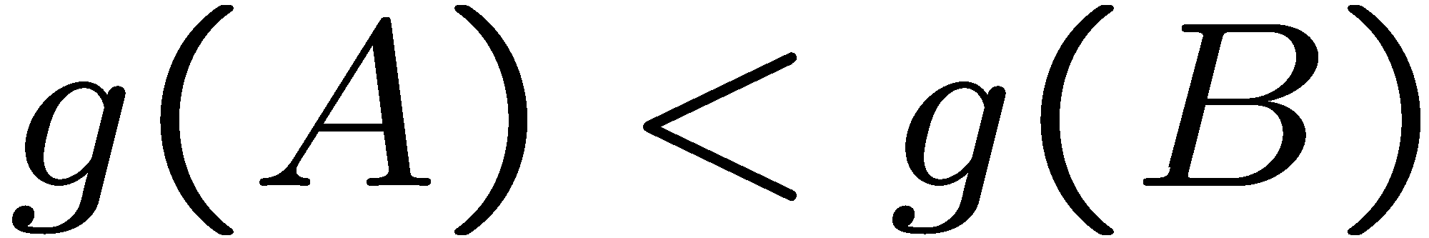
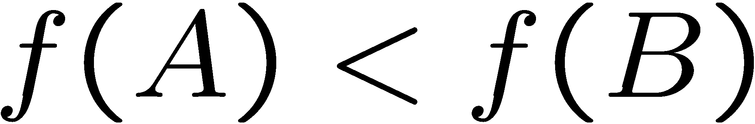
Optimality of A* Tree Search: Blocking
Proof:
Imagine B is on the fringe
Some ancestor n of A is on the fringe, too (maybe A!)
Claim: n will be expanded before B
f(n) is less or equal to f(A)
f(A) is less than f(B)
…
B is suboptimal
h = 0 at a goal

Slide 36

Optimality of A* Tree Search: Blocking
Proof:
Imagine B is on the fringe
Some ancestor n of A is on the fringe, too (maybe A!)
Claim: n will be expanded before B
f(n) is less or equal to f(A)
f(A) is less than f(B)
n expands before B
All ancestors of A expand before B
A expands before B
A* search is optimal
…

Slide 37
Properties of A*

Slide 38
Properties of A*
Uniform-Cost
A*
b
b
…
…

Slide 39
UCS vs A* Contours
Uniform-cost expands equally in all “directions”
A* expands mainly toward the goal, but does hedge its bets to ensure optimality
Start
Goal
Start
Goal
[Demo: contours UCS / greedy / A* empty (L3D1)]
[Demo: contours A* pacman small maze (L3D5)]

Slide 40
Video of Demo Contours (Empty) -- UCS

Slide 41
Video of Demo Contours (Empty) -- Greedy

Slide 42
Video of Demo Contours (Empty) – A*

Slide 43
Video of Demo Contours (Pacman Small Maze) – A*

Slide 44
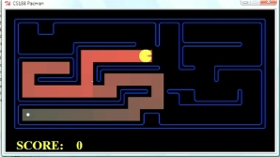
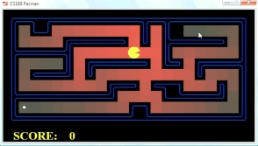
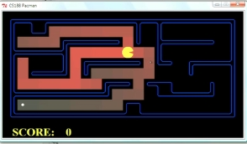
Comparison
Greedy
Uniform Cost
A*

Slide 45
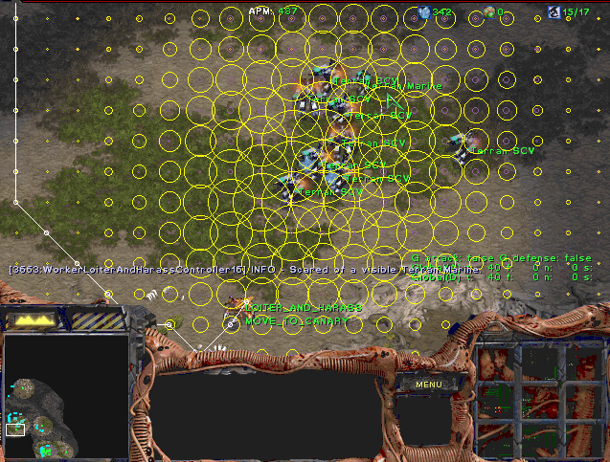
A* Applications

Slide 46
A* Applications
Video games
Pathing / routing problems
Resource planning problems
Robot motion planning
Language analysis
Machine translation
Speech recognition
…
[Demo: UCS / A* pacman tiny maze (L3D6,L3D7)]
[Demo: guess algorithm Empty Shallow/Deep (L3D8)]

Slide 47
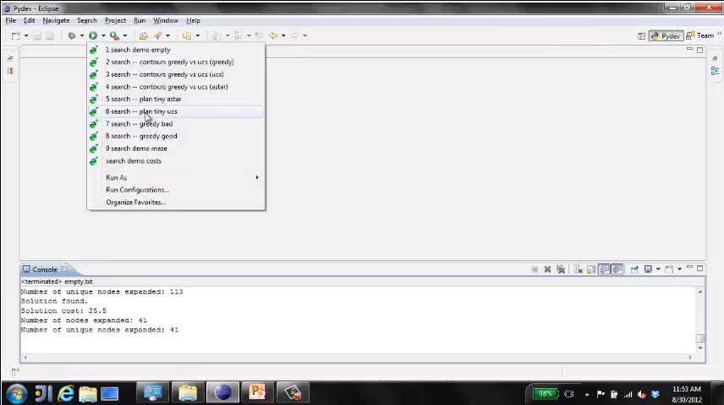
Video of Demo Pacman (Tiny Maze) – UCS / A*

Slide 48
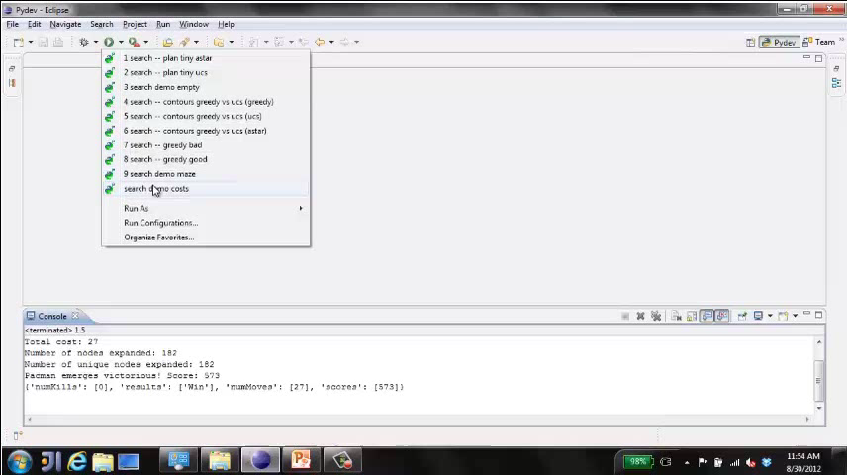
Video of Demo Empty Water Shallow/Deep – Guess Algorithm

Slide 49

Creating Heuristics

Slide 50
Creating Admissible Heuristics
Most of the work in solving hard search problems optimally is in coming up with admissible heuristics
Often, admissible heuristics are solutions to relaxed problems, where new actions are available
Inadmissible heuristics are often useful too
366
15

Slide 51
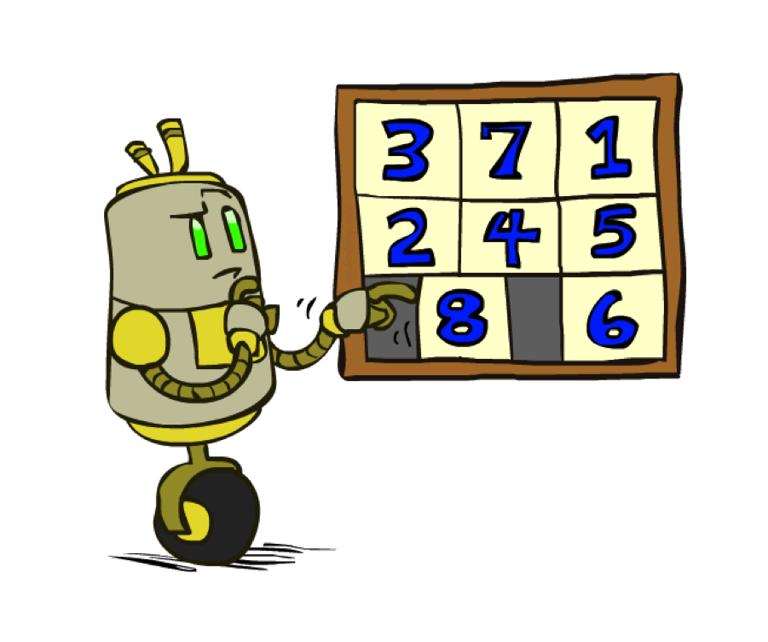
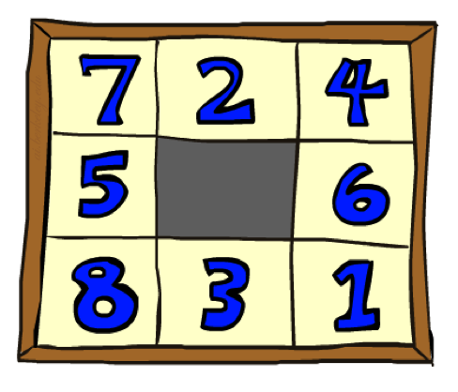
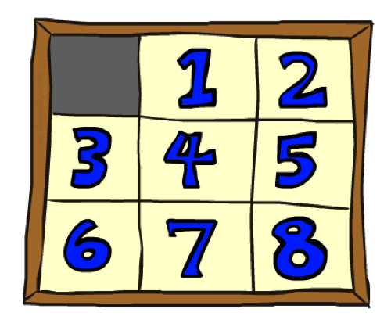
Example: 8 Puzzle
Start State
Actions
Goal State
What are the states?
How many states?
What are the actions?
How many successors from the start state?
What should the costs be?

Slide 52
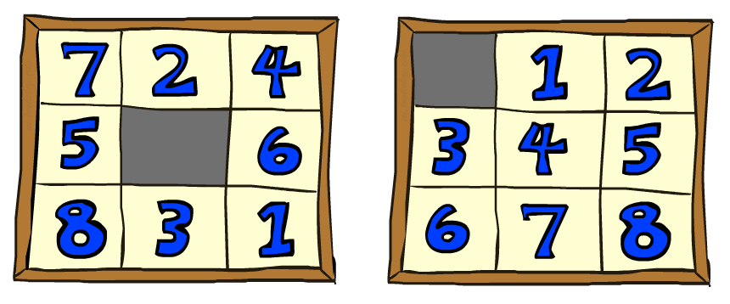
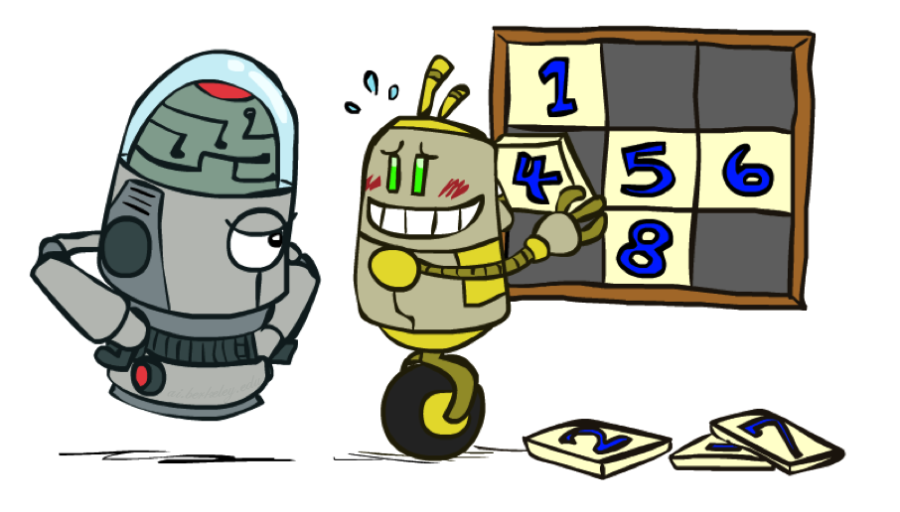
8 Puzzle I
Heuristic: Number of tiles misplaced
Why is it admissible?
h(start) =
This is a relaxed-problem heuristic
8
Start State
Goal State
 | Average nodes expanded when the optimal path has…
 | …4 steps | …8 steps | …12 steps
UCS | 112 | 6,300 | 3.6 x 10⁶
TILES | 13 | 39 | 227
Statistics from Andrew Moore

Slide 53
8 Puzzle II
What if we had an easier 8-puzzle where any tile could slide any direction at any time, ignoring other tiles?
Total Manhattan distance
Why is it admissible?
h(start) =
Start State
Goal State
 | Average nodes expanded when the optimal path has…
 | …4 steps | …8 steps | …12 steps
TILES | 13 | 39 | 227
MANHATTAN | 12 | 25 | 73
3 + 1 + 2 + … = 18

Slide 54
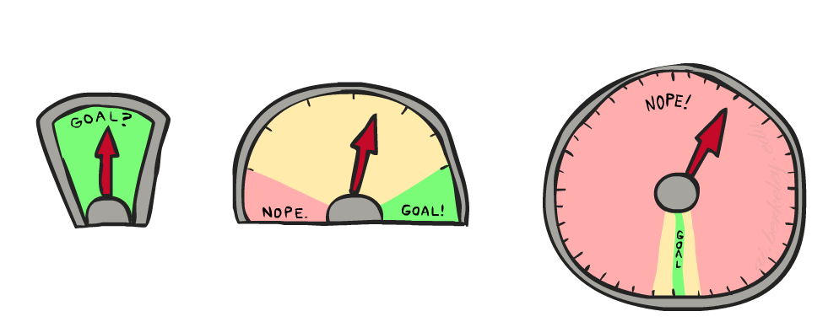
8 Puzzle III
How about using the actual cost as a heuristic?
Would it be admissible?
Would we save on nodes expanded?
What’s wrong with it?
With A*: a trade-off between quality of estimate and work per node
As heuristics get closer to the true cost, you will expand fewer nodes but usually do more work per node to compute the heuristic itself

Slide 55
Semi-Lattice of Heuristics

Slide 56







Trivial Heuristics, Dominance
Dominance: h_{a} ≥ h_{c} if
Heuristics form a semi-lattice:
Max of admissible heuristics is admissible
Trivial heuristics
Bottom of lattice is the zero heuristic (what does this give us?)
Top of lattice is the exact heuristic
Notes:
Semi-lattice: x <= y <-> x = x ^ y

Slide 57
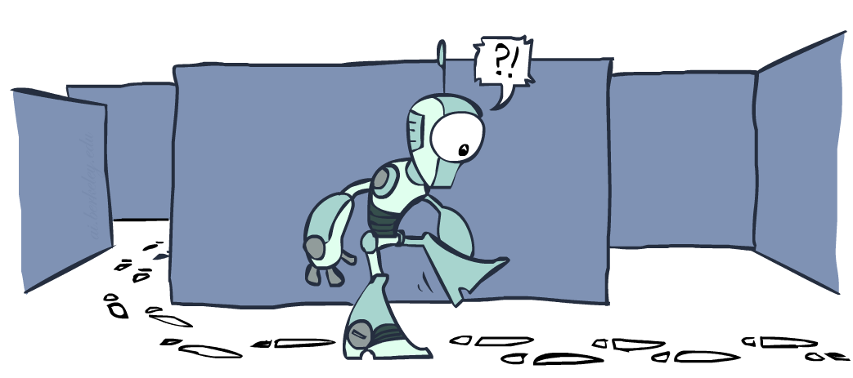
Graph Search

Slide 58
Tree Search: Extra Work!
Failure to detect repeated states can cause exponentially more work.
State Graph
Search Tree

Slide 59
Graph Search
In BFS, for example, we shouldn’t bother expanding the circled nodes (why?)
S
d
e
p
b
c
e
h
r
q
a
a
h
r
p
q
f
p
q
f
q
c
G
q
c
G
a
a

Slide 60
Graph Search
Idea: never expand a state twice
How to implement:
Tree search + set of expanded states (“closed set”)
Expand the search tree node-by-node, but…
Before expanding a node, check to make sure its state has never been expanded before
If not new, skip it, if new add to closed set
Important: store the closed set as a set, not a list
Can graph search wreck completeness? Why/why not?
How about optimality?

Slide 61
A* Graph Search Gone Wrong?
State space graph
Search tree
A
S (0+2)
1
S
1
C
h=4
h=1
A (1+4)
B (1+1)
h=2
1
2
B
3
C (2+1)
C (3+1)
h=1
G
G (5+0)
G (6+0)
h=0

Slide 62
Consistency of Heuristics
Main idea: estimated heuristic costs ≤ actual costs
Admissibility: heuristic cost ≤ actual cost to goal
h(A) ≤ actual cost from A to G
Consistency: heuristic “arc” cost ≤ actual cost for each arc
h(A) – h(C) ≤ cost(A to C)
Consequences of consistency:
The f value along a path never decreases
h(A) ≤ cost(A to C) + h(C)
A* graph search is optimal
A
1
C
h=4
h=1
h=2
3
G

Slide 63
Optimality of A* Graph Search

Slide 64
Optimality of A* Graph Search
Sketch: consider what A* does with a consistent heuristic:
Fact 1: In tree search, A* expands nodes in increasing total f value (f-contours)
Fact 2: For every state s, nodes that reach s optimally are expanded before nodes that reach s suboptimally
Result: A* graph search is optimal
…
f ≤ 1
f ≤ 2
f ≤ 3

Slide 65
Optimality
Tree search:
A* is optimal if heuristic is admissible
UCS is a special case (h = 0)
Graph search:
A* optimal if heuristic is consistent
UCS optimal (h = 0 is consistent)
Consistency implies admissibility
In general, most natural admissible heuristics tend to be consistent, especially if from relaxed problems

Slide 66

A*: Summary

Slide 67

A*: Summary
A* uses both backward costs and (estimates of) forward costs
A* is optimal with admissible / consistent heuristics
Heuristic design is key: often use relaxed problems

Slide 68
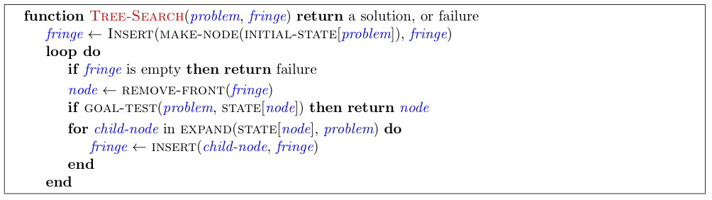
Tree Search Pseudo-Code

Slide 69
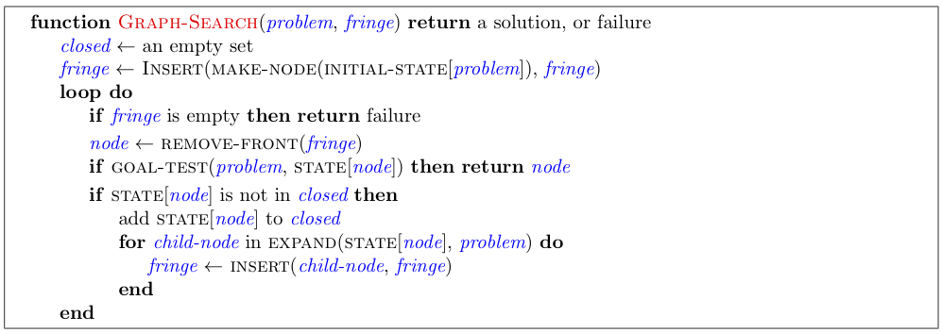
Graph Search Pseudo-Code

Slide 70
Optimality of A* Graph Search
Consider what A* does:
Expands nodes in increasing total f value (f-contours) Reminder: f(n) = g(n) + h(n) = cost to n + heuristic
Proof idea: the optimal goal(s) have the lowest f value, so it must get expanded first
…
f ≤ 1
There’s a problem with this argument. What are we assuming is true?
f ≤ 2
f ≤ 3

Slide 71

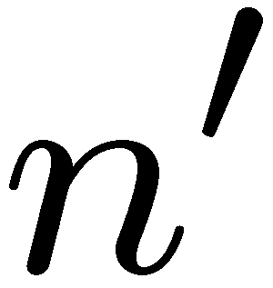
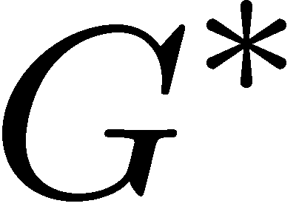

Optimality of A* Graph Search
Proof:
New possible problem: some n on path to G* isn’t in queue when we need it, because some worse n’ for the same state dequeued and expanded first (disaster!)
Take the highest such n in tree
Let p be the ancestor of n that was on the queue when n’ was popped
f(p) < f(n) because of consistency
f(n) < f(n’) because n’ is suboptimal
p would have been expanded before n’
Contradiction!

